Slide 1


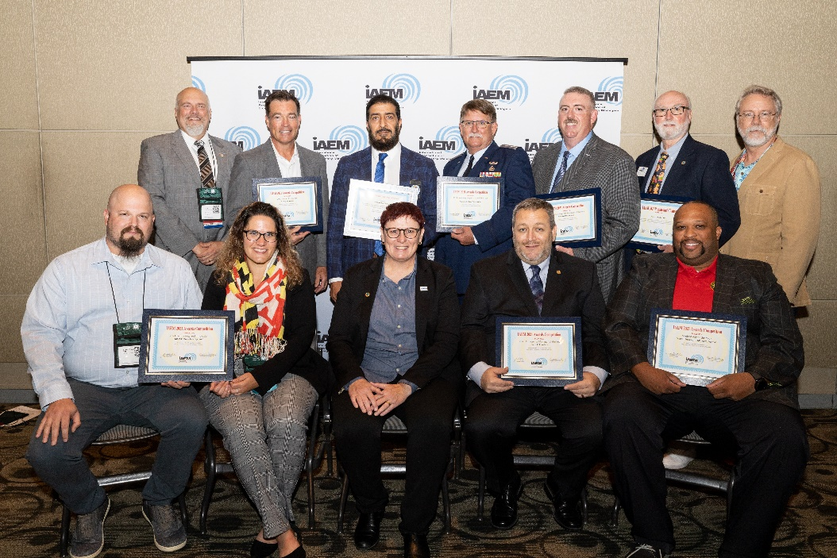
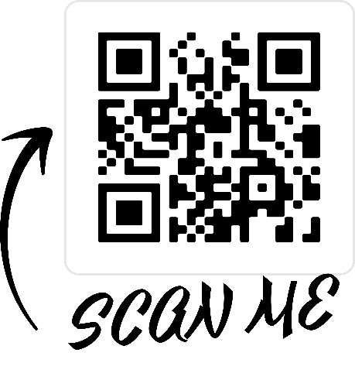
AWARDS AND RECOGNITION
Mission
The IAEM Awards Program recognizes and honors programs that have and individuals who have made special or significant contributions to the field of emergency management.
Award categories
For more information and to join us …
Business and Private Sector Integration and Public Sector Partnership Award
Career Excellence Award
Clayton R. Christopher Memorial Award
Emergency Manager of the Year Award
Preparedness Award
Rising Star Award
Student Advocate of the Year Award
Student Chapter of the Year Award
Student of the Year Award
Technology and Innovation Award
USC Auxiliary Emergency Manager of the Year
USC Civilian Emergency Manager of the Year
USC Uniformed Emergency Manager of the Year
Voluntary Organization of the Year
Volunteer of the Year
Award Winners 2021 Conference
Leadership
Committee Chair:
Lanita A. Lloyd, CEM
Committee Vice Chair:
Justin A. Cox, CEM
Board Liaison:
Sarah Moore, IAEM-USA Secretary

